Slide 1
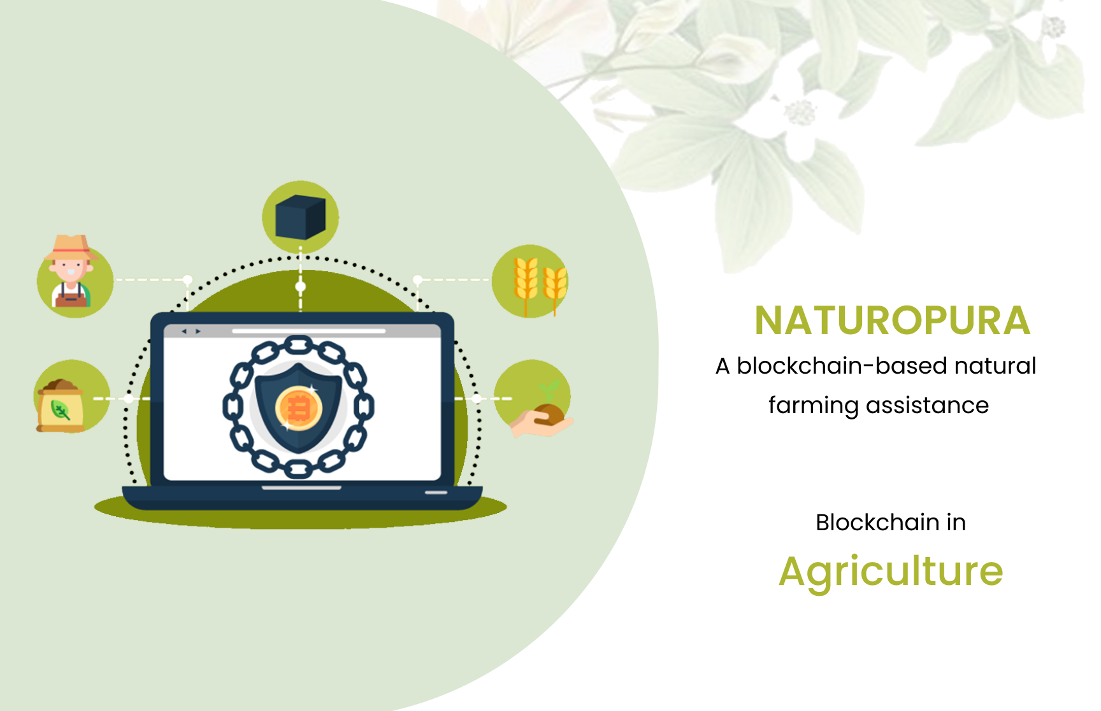

Slide 2


Contents:
What is Naturopura
Why Naturopura
Objective
Software Solution
Business Model
Technical Approach
Prototype Costing
Impact of the Project

Slide 3
What is Naturopura?
The system works along with the natural biodiversity of each farmed area, encouraging the complexity of living organisms—both plant and animal—that shape each particular ecosystem to thrive along with food plants.
Natural farming is related to fertility farming, organic farming, and biodynamic agriculture.
Natural farming and organic farming, both come under agroecological practices. In natural farming, the focus is on the use of bio inputs prepared from farms and local ecosystems instead of purchasing those from outside.

Slide 4
Why Naturopura?
A hassle-free platform for the farmers of the Agri Market in India.
A medium to Sell/ Buy products produced by the farmers.
Farmers / Consumers post their requirements to purchase.
Best site for e-commerce in Agriculture.
With the help of the Internet, we can digitalize the whole unorganized agricultural supply chain into a stable and eﬀective aggregation-based platform that shall act as a network for all the stakeholders such as Farmers, Cold Storage, Processors, Wholesalers, Traders & Retailers.
This digital aggregation platform shall help the stakeholders in better dissemination of information on a real-time basis, sustainable use of resources, streamlining of trading procedures, diversification of products & Markets, simplified & safe trading partnerships, and better supply chain network.

Slide 5

Objective of Naturepura
Farmers
Consultants
& Institutions
Cold Storages, Distributors & Retailers
Agriculture
Ecosystem
Exporters &
Marketing Agencies
End Consumers
Equipment Manufacturers & Suppliers
Processing Industries
Agricultural Products

Slide 6
Objective of Naturepura
The objective of this proposal is to create an all-in-one unified digital platform, which shall create a dynamic network among all the stakeholders in Naturopura.
What for Farmers?
To facilitate diversified sales channels for eﬀective selling of their produce.
To facilitate fair compensation for their produce.
To facilitate better planning of logistics.
To facilitate farmers to explore the domain of backward and forward integration.
To facilitate digitalized procurement of better feed, equipment, and other necessary items at a lower price with the elimination of any middleman.
To provide direct digital linkage and network to Processing Industries, Cold Chains, Traders & Wholesalers.
To facilitate digital buying and selling of Agri -based inputs & outputs for them in a single unified platform.

Slide 7
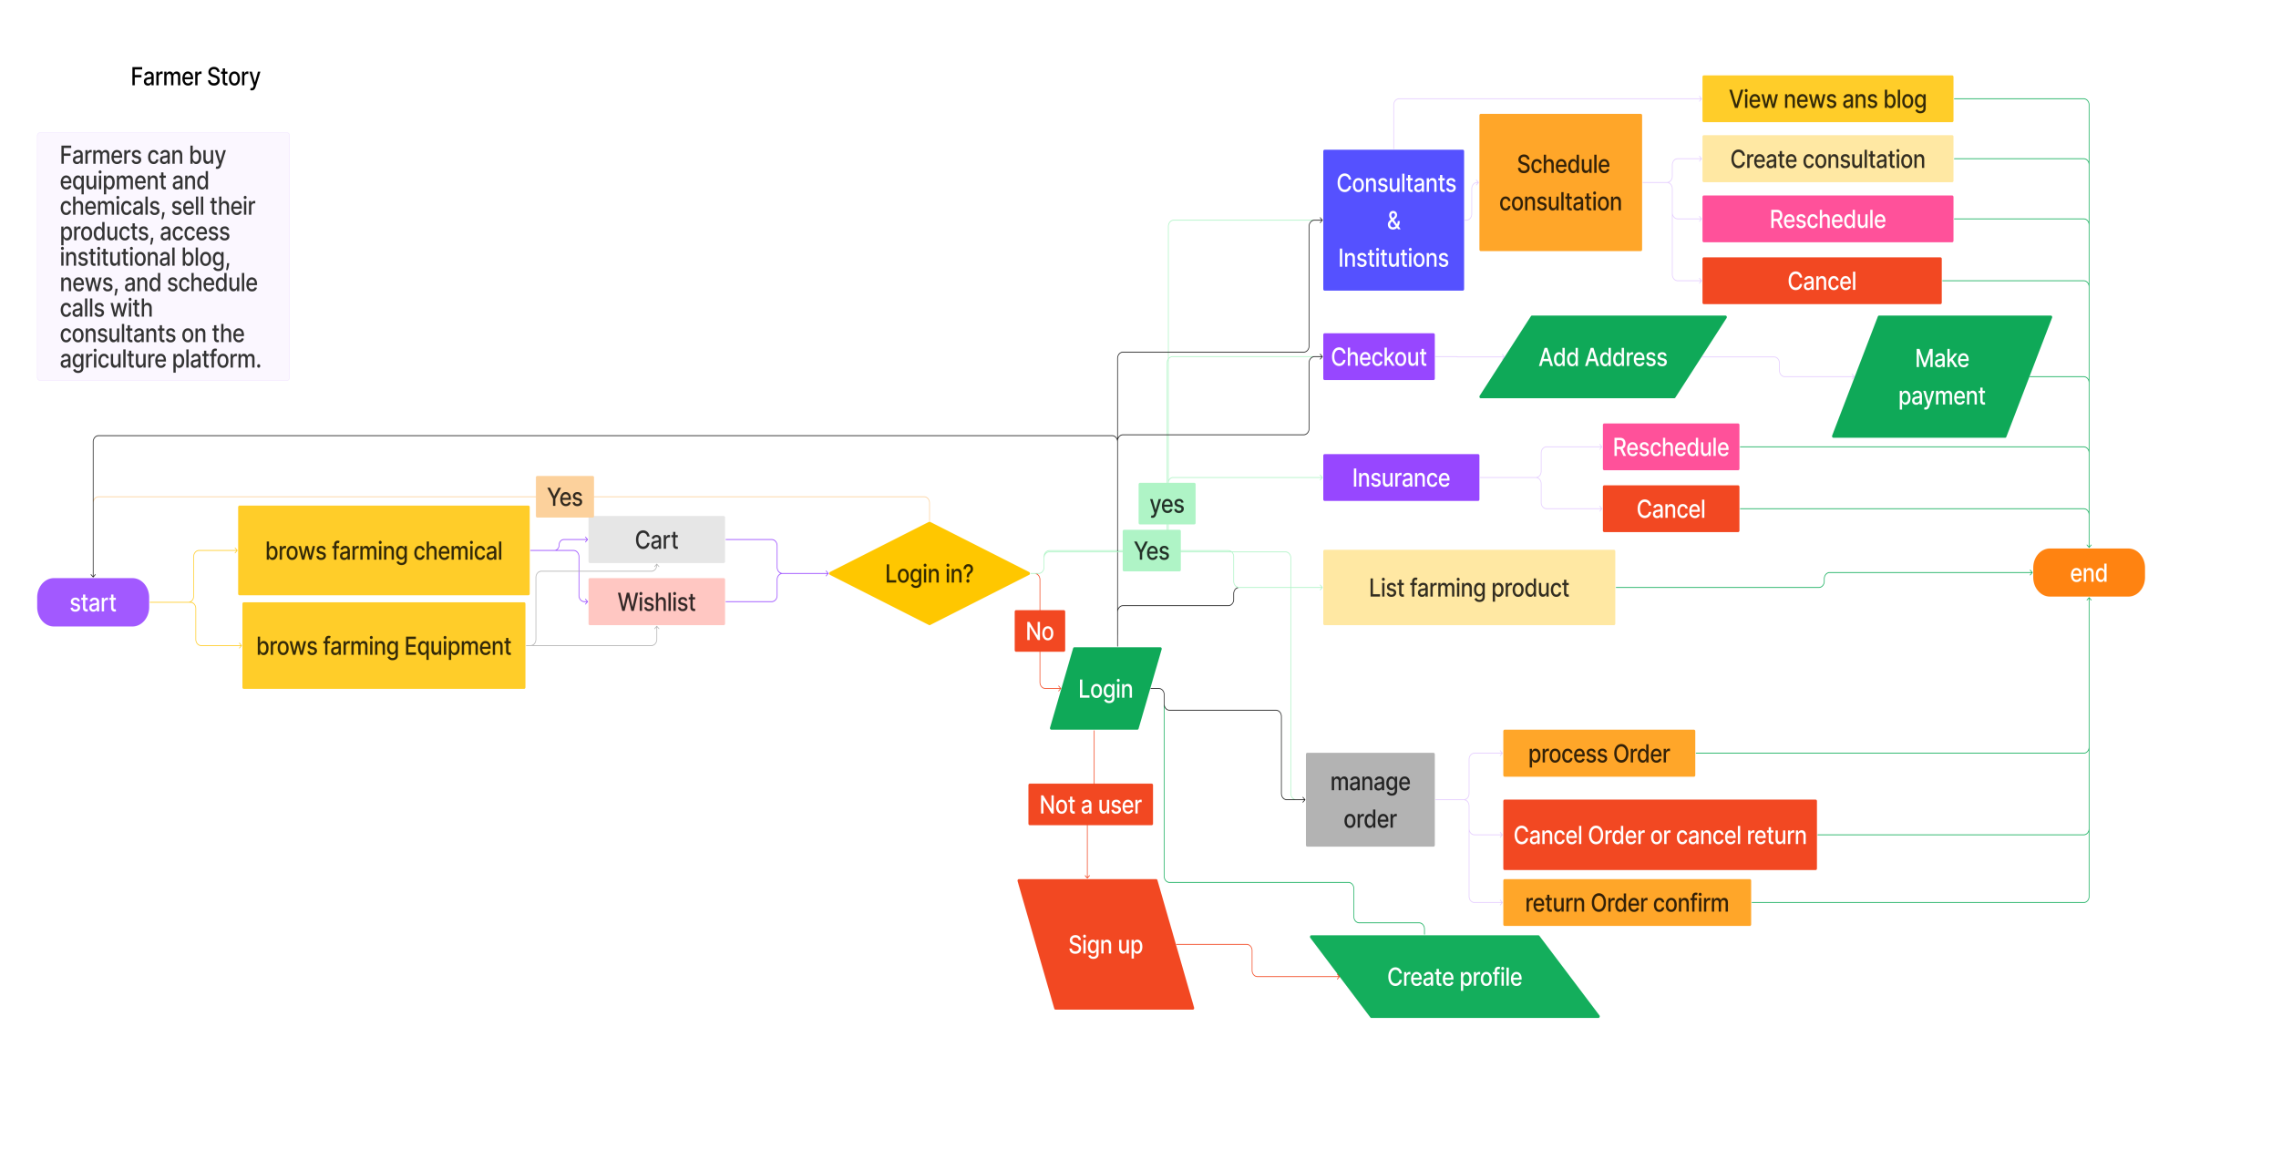
Objective of Naturepura

Slide 8
Objective of Naturepura
What for Agricultural Products, Distributors, Wholesalers & Retailers?
To facilitate direct procurement of produce from the farmers.
To facilitate a reduction in logistics costs by streamlining the supply chain.
To facilitate a unified platform to access a diverse range of products.
To facilitate a platform to sell their products on a larger scale.
To facilitate a market analysis model, this will assist them in getting the right price for their produce by analyzing the demand and supply in the market.
To facilitate an efficient hyperlocal delivery service to retailers for their e-commerce.
What for Consumers?
To facilitate a platform to buy a large variety of Agriculture products online.
To facilitate an online marketplace, that will reduce the cost of pro production cause of the competition between online sellers.
To facilitate a review-based system that will help them in choosing the right sellers for their produce.

Slide 9
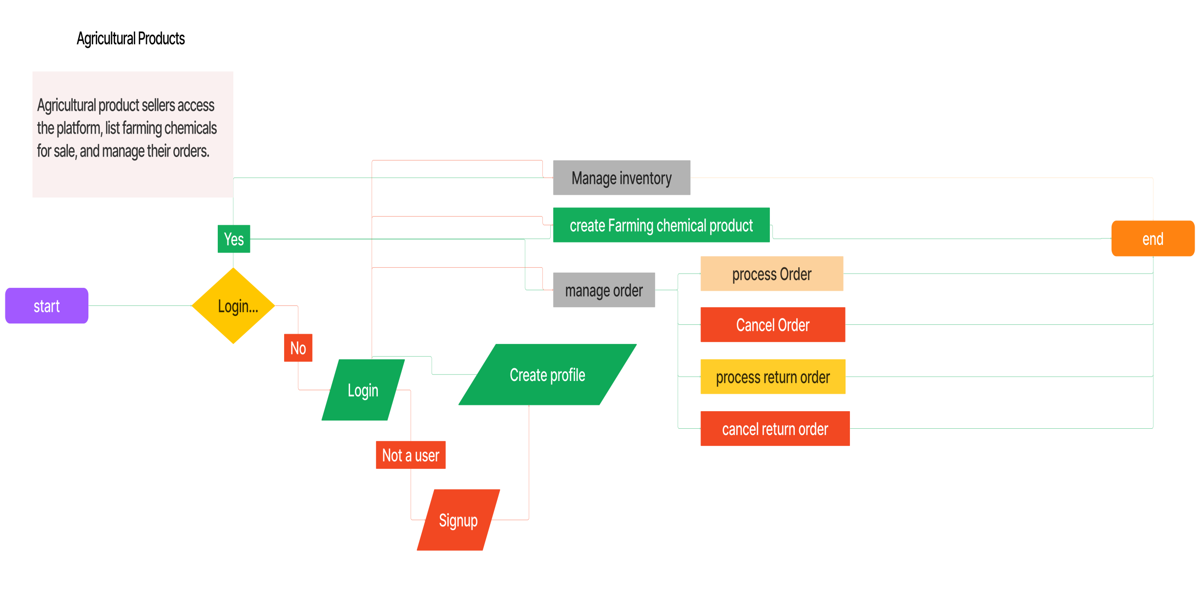
Objective of Naturepura

Slide 10
Objective of Naturepura
What for Equipment Manufacturers & Suppliers?
To facilitate an e-commerce platform to sell their products directly to the end-user.
To facilitate a marketing model to increase their market outreach.
To facilitate a review-based model to help them understand the problems of the end-users and solve them.
To facilitate a logistical system to deliver their products to the end-users.
What for Exporters & Marketing Agencies?
To facilitate direct procurement of diﬀerent products from the farmers & processing industries.
To facilitate them with an efficient supply chain that will help them with their operations.

Slide 11
Software Solution
The solution which we propose is an integrated web and mobile app platform powered by a Dynamic agro Based intermediary platform Model with a digitalized networking and linking of all the stakeholders of the agriculture-based supply chain under one platform to be called Naturopura.
Naturopura encompasses multiple modules with a wide range of functionalities such as an E-commerce retail marketplace, an E-Trade module for bulk trading of produce, and an E-service module for consultancy & technological intervention-based.
The E-commerce retail marketplace shall act as a one-stop solution.
The E-trading module shall act as a marketplace for bulk purchases.
The E-service module shall act as a knowledge bank, insurance, consultation etc..

Slide 12
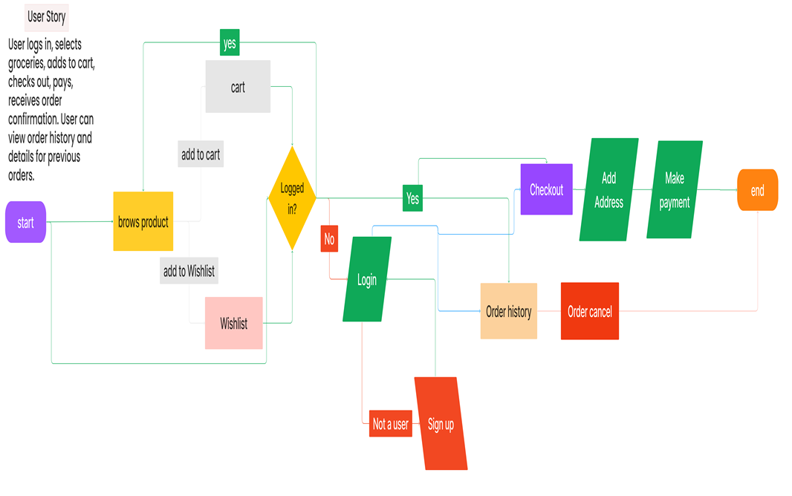
User Model

Slide 13















Business Model
On boarding of Stakeholders
Proﬁle Creation of Users
User Veriﬁcation or Authentication
Consumer
Consumers
Enquiry, Orders & Sales Listing
Categorization of Stakeholders
Raw Material & Product Listing
Farmer
E-Market Blockchain
Processing Industry
Consumer
Mapping of Users as per Enquiry
Digitalized Order Booking
Digitalized Payment Module
Consumer
Retailers
Sales through Integrated E-Commerce

Slide 14
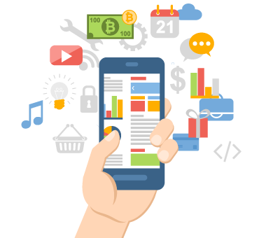
Technical Approach
By providing a single source of data for a farm, blockchain would minimize the strain of record keeping and maintaining multiple record systems.
It ultimately saves time and energy in the agriculture value chain.
It is very important to realize that the blockchain alone can’t make growers more money, but it can provide the technology infrastructure for things like automation, digitization, and tracking, that could drive the farmers towards modern agriculture.

Slide 15
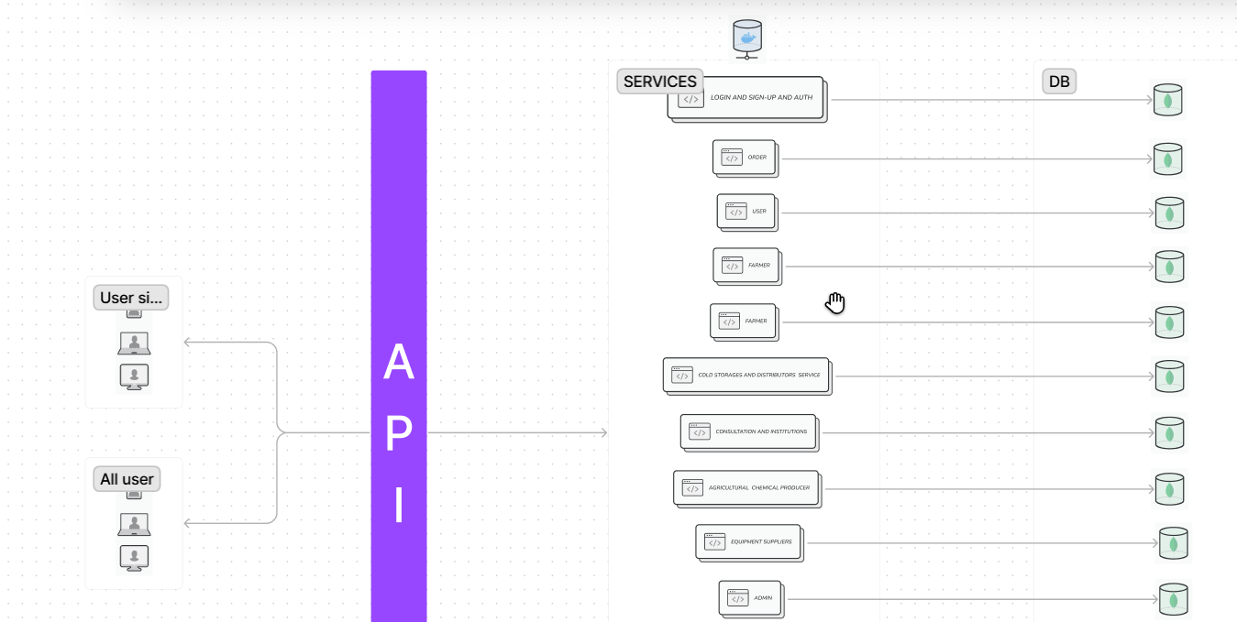
Technical Approach

Slide 16
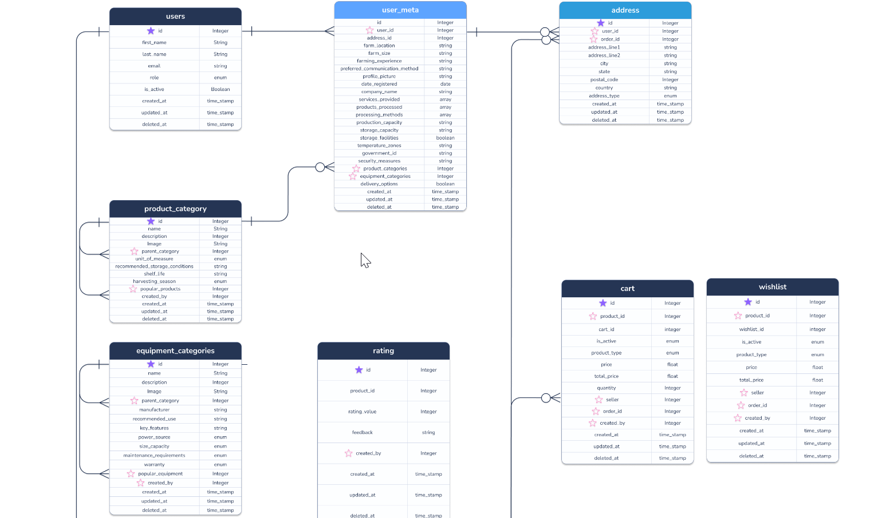
Technical Approach

Slide 17
BLOCKCHAIN TECHNOLOGY IN CURRENT AGRICULTURAL SYSTEMS
The major technological challenges can be summarized as the following aspects:
(i) scalability issue when integrating with data-intensive technology, such as IoT. The throughput of blockchain is much lower than the conventional centralized databases, which can achieve tens to hundreds of thousands of transactions per second. Therefore, data-intensive applications, e.g. monitoring and controlling farming by a sensor network, require fast storage speed and low network latency;
(ii) integration with existing legacy systems. Many organizations have deployed their own management systems for years and it is hard to migrate their entire systems to the emerging blockchain which could cause disruption to their current services;
(iii) security and privacy. Blockchain encourages a decentralized infrastructure that increases data transparency but compromises data privacy. Although most recent blockchain platforms allow the uploading of encrypted transaction records on-chain, more security features would enhance data security and privacy to a higher level due to various types of attacks. Blockchain systems are difficult to seamlessly integrate with legacy systems.

Slide 18
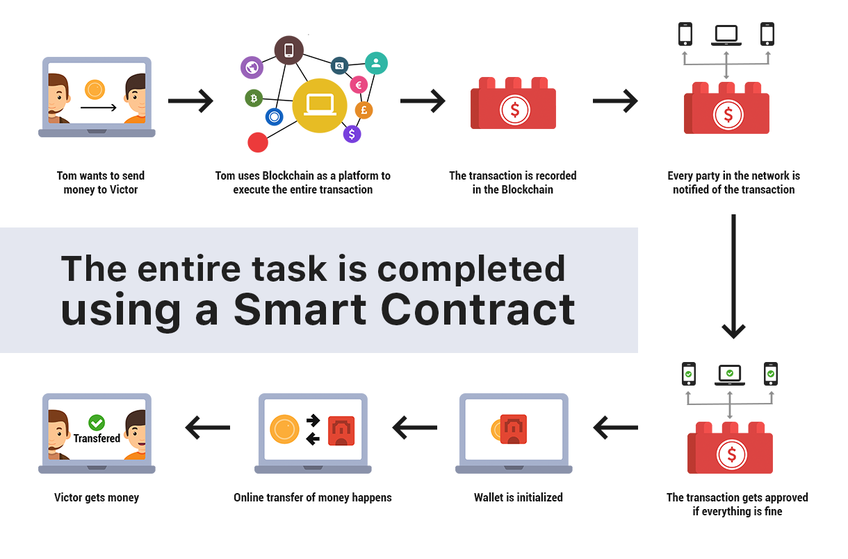
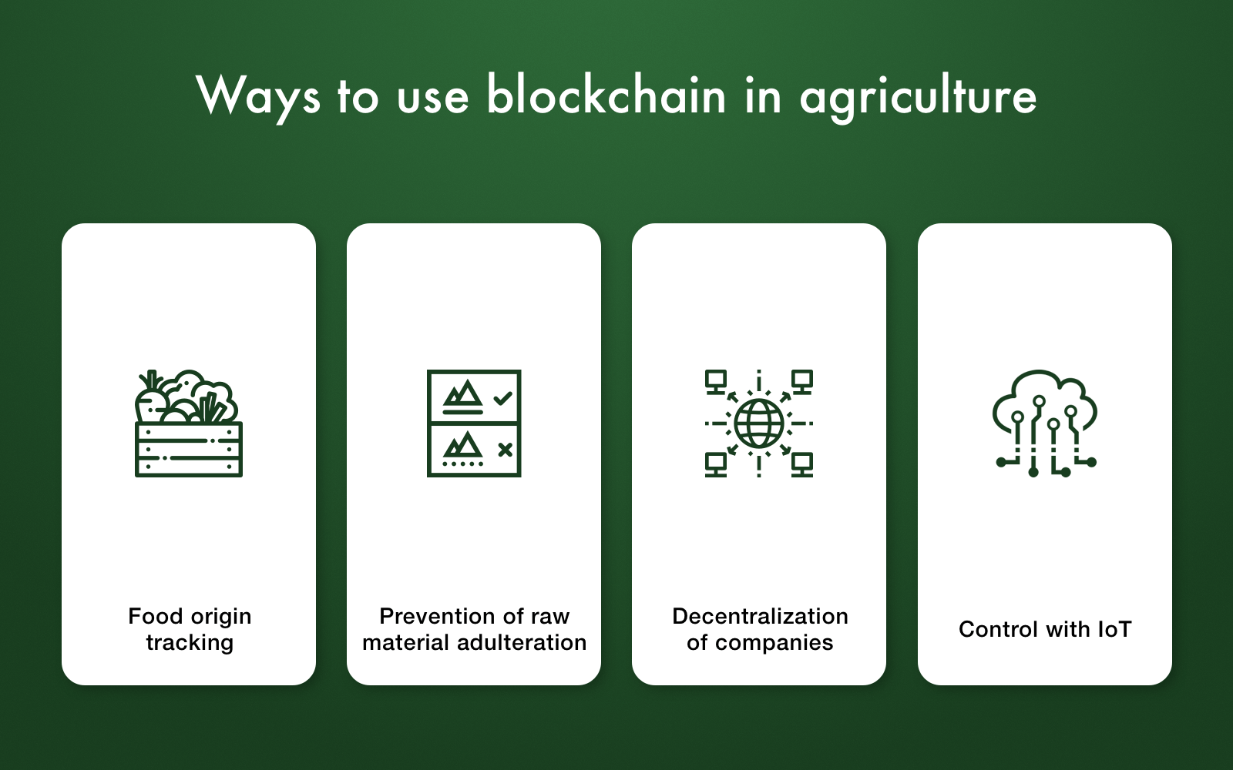
BLOCKCHAIN TECHNOLOGY IN CURRENT AGRICULTURAL SYSTEMS
we have presented a comprehensive survey on current blockchain-based agricultural applications and innovations. We have offered a detailed investigation of desperate blockchain applications in the agricultural sector. the current use of blockchain-related technologies in agricultural applications and provided some possible solutions. These challenges include:
(1) scalability,
(2) integration with existing legacy systems
(3) security and privacy.

Slide 19
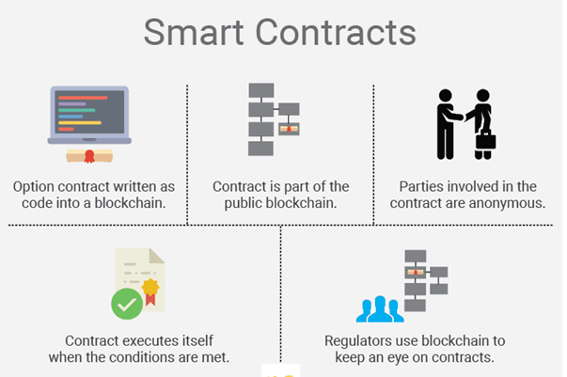
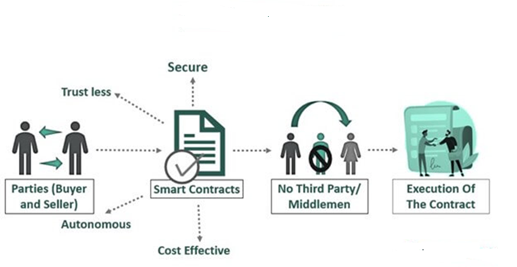
Smart Contracts
Smart contracts are computer programs or protocols for automated transactions that are stored on a blockchain and run in response to meeting certain conditions. In other words, smart contracts automate the execution of agreements so that all participants can ascertain the outcome as soon as possible without the involvement of an intermediary or time delay.

